Slide 1
AI Tasks
Lecture 2

Slide 2
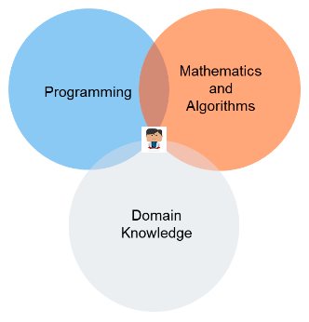



What is data science?
Data science is the field of study that combines:
domain expertise
programming skills
knowledge of mathematics and statistics
Notes:
https://www.datarobot.com/wiki/data-science/

Slide 3
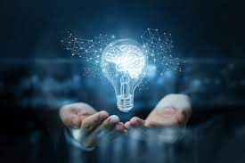
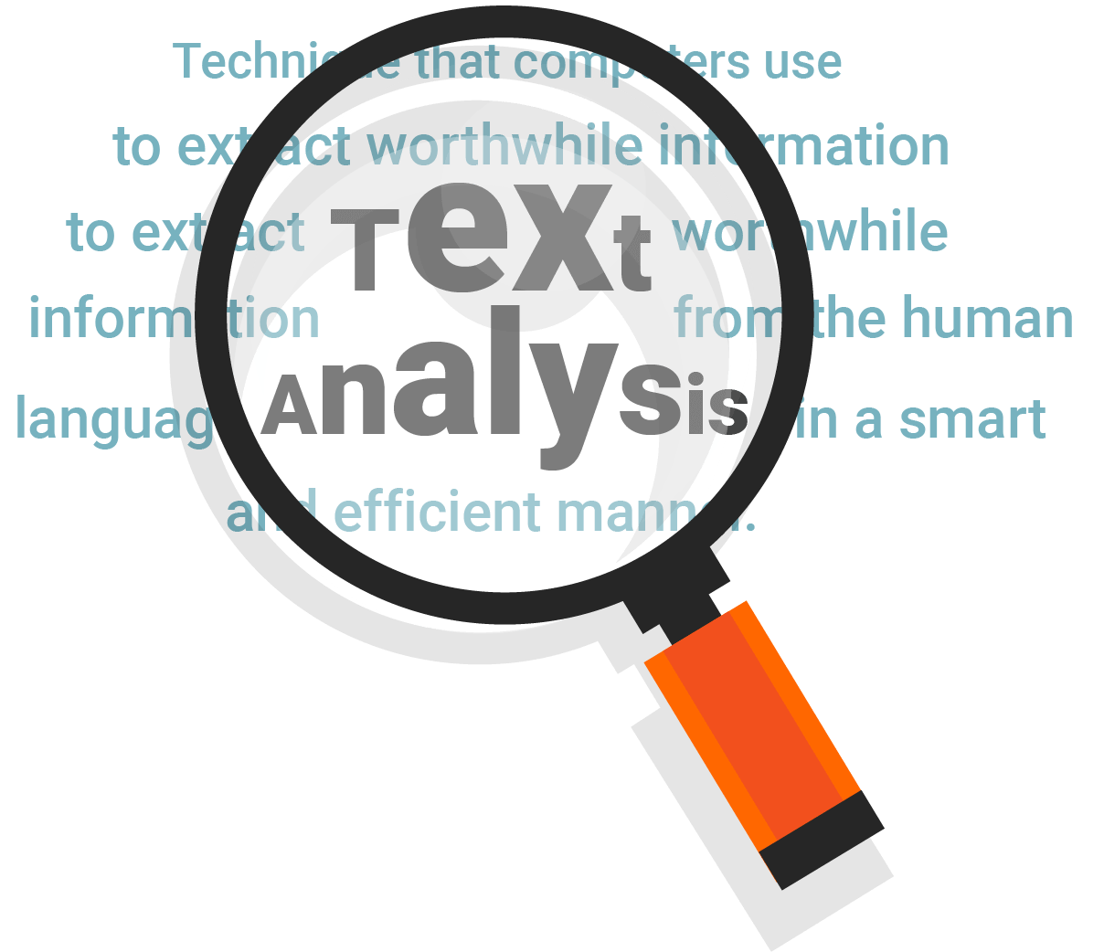


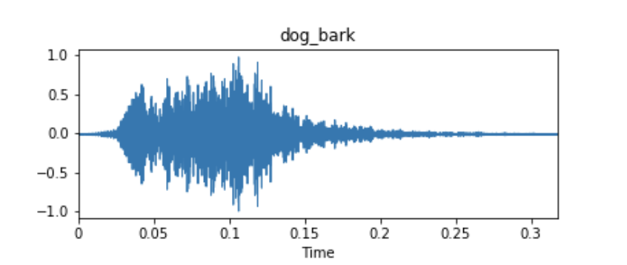
What is the goal of data science?
Goal: extracting meaningful insights from data.
Data science practitioners apply machine learning algorithms to:
numbers,
text,
images,
video,
audio, and more

Slide 4

What is the goal of data science?
i.e., to produce artificial intelligence (AI) systems to perform tasks that ordinarily require human intelligence.
In turn, these systems generate insights which analysts and business users can translate into tangible business value.

Slide 5

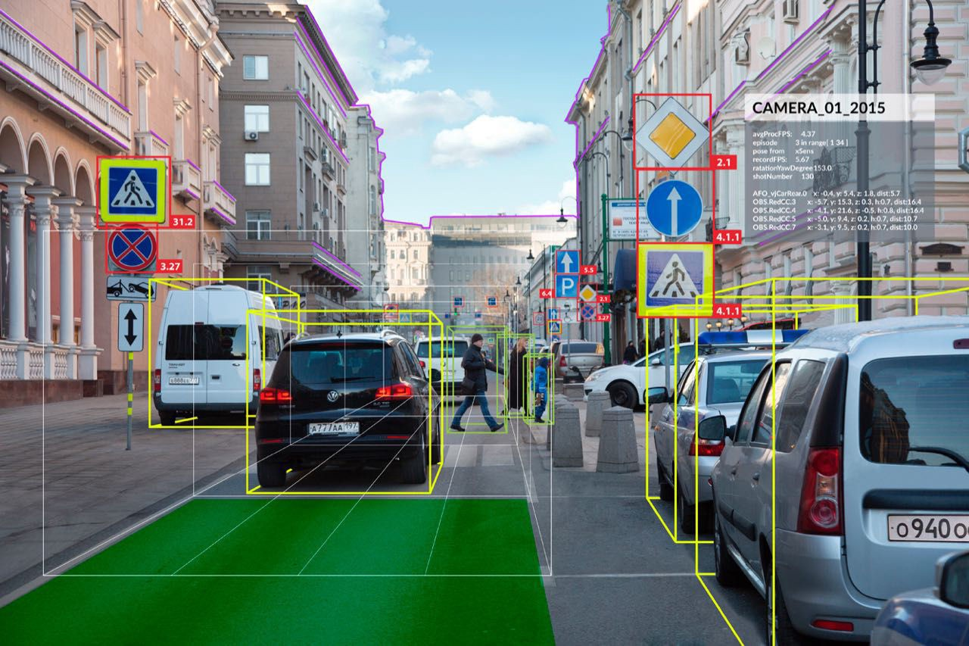

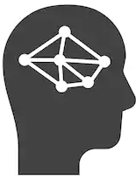
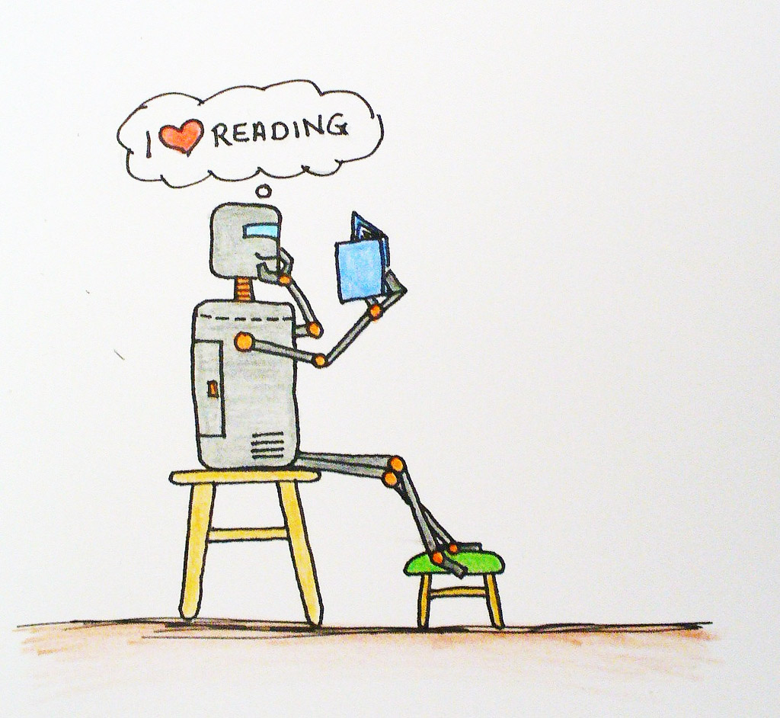
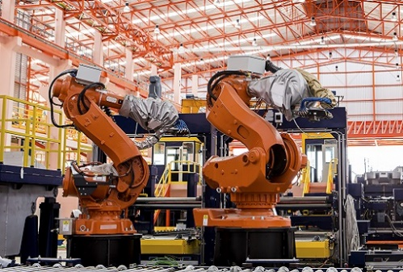

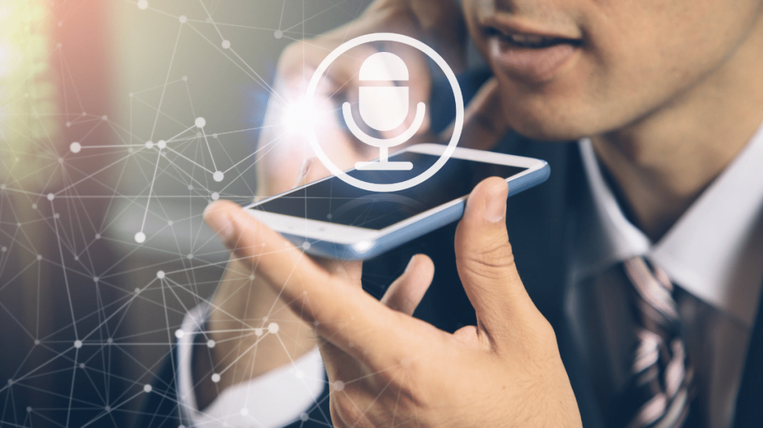
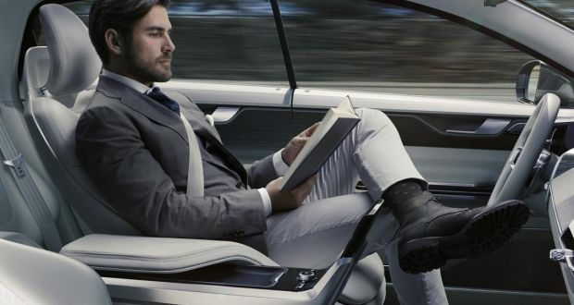
AI imitates human capabilities
Search & Optimization
Computer vision
Reasoning Under Uncertainty
Natural language
processing
Robotics
Speech recognition
Planning
Autonomous Systems

Slide 6
AI imitates human capabilities
Search & Optimization
Computer vision
Reasoning Under Uncertainty
Natural language
processing
Robotics
Speech recognition
Planning
Autonomous Systems

Slide 7
Computer Vision
The area of computer vision basically deals with anything that humans see and perceive.
Computer Vision Tasks:
Object Detection
Image Classification
Visual Relationship Detection
Image Captioning
Image Reconstruction or Image Inpainting
Face Recognition
Instance Segmentation
Semantic Segmentation
Notes:
https://ananya-banerjee.medium.com/different-computer-vision-tasks-b3b49bbae891

Slide 8
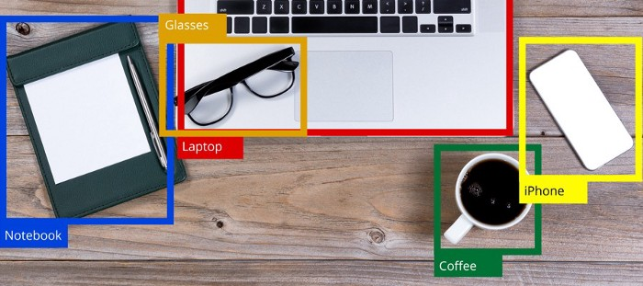
Object Detection
Object Detection is the ability to detect or identify objects in any given image correctly along with their spatial position in the given image, in the form of rectangular boxes (known as Bounding Boxes). which bound the object within it.
Notes:
Source: https://medium.com/analytics-vidhya/beginners-guide-to-object-detection-algorithms-6620fb31c375

Slide 9
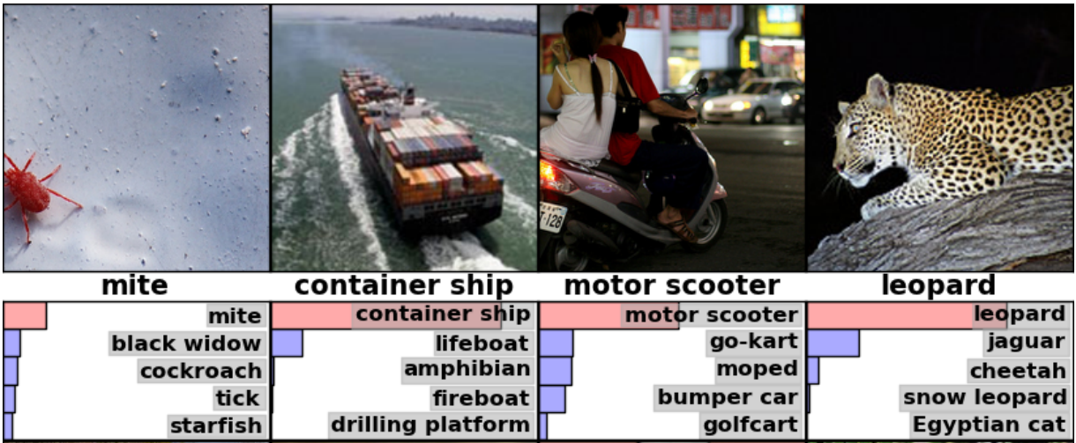
Image Classification
Image Classification basically means identifying what class the object belongs to.
For example, in the image shown below, there are objects present belonging to various classes such as trees, huts, giraffe, etc.
The machine or deep learning model would determine that the animal detected in the image belongs to class giraffe with the highest probability.
Notes:
Source: https://medium.com/analytics-vidhya/beginners-guide-to-object-detection-algorithms-6620fb31c375

Slide 10
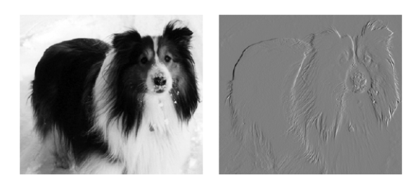
Vertical Filters Example
By subtracting from the value of each pixel the value of the neighbor to its left, we can obtain the outline of the image

Slide 11


1
1
-1
0
1
1
0
-1
-1
-1
0
0
3 | 0 | 1 | 2 | 7 | 4
1 | 5 | 8 | 9 | 3 | 1
2 | 7 | 2 | 5 | 1 | 3
0 | 1 | 3 | 1 | 7 | 8
4 | 2 | 1 | 6 | 2 | 8
2 | 4 | 5 | 2 | 3 | 9
1
1
1
1
1
0
-1
0
-1
1
0
-1
1
1
0
-1
0
-1
-1
-1
-1
0
0
0
-5 | -4 | 0 | 8
10 | -2 | 2 | 3
1 | 0 | -1
1 | 0 | -1
1 | 0 | -1
1
1
1
1
0
-1
0
0
-1
1
0
0
-1
-1
1
-1
1
0
-1
1
0
-1
0
-1
$$∗$$
$$=$$
1
0
-1
1
0
-1
1
1
0
-1
0
-1
0 | -2 | -4 | -7
-3 | -2 | -3 | -16
6x6x1 image (grayscale)
3x3 filter
4x4x1 layer

Slide 12



Vertical edge detection
10 | 10 | 10 | 0 | 0 | 0
10 | 10 | 10 | 0 | 0 | 0
10 | 10 | 10 | 0 | 0 | 0
10 | 10 | 10 | 0 | 0 | 0
10 | 10 | 10 | 0 | 0 | 0
10 | 10 | 10 | 0 | 0 | 0
0 | 30 | 30 | 0
0 | 30 | 30 | 0
0 | 30 | 30 | 0
0 | 30 | 30 | 0
1 | 0 | -1
1 | 0 | -1
1 | 0 | -1
$$∗$$
$$=$$
$$∗$$

Slide 13



Vertical edge detection examples
10 | 10 | 10 | 0 | 0 | 0
10 | 10 | 10 | 0 | 0 | 0
10 | 10 | 10 | 0 | 0 | 0
10 | 10 | 10 | 0 | 0 | 0
10 | 10 | 10 | 0 | 0 | 0
10 | 10 | 10 | 0 | 0 | 0
0 | 30 | 30 | 0
0 | 30 | 30 | 0
0 | 30 | 30 | 0
0 | 30 | 30 | 0
1 | 0 | -1
1 | 0 | -1
1 | 0 | -1
$$∗$$
$$=$$
0 | 0 | 0 | 10 | 10 | 10
0 | 0 | 0 | 10 | 10 | 10
0 | 0 | 0 | 10 | 10 | 10
0 | 0 | 0 | 10 | 10 | 10
0 | 0 | 0 | 10 | 10 | 10
0 | 0 | 0 | 10 | 10 | 10
0 | -30 | -30 | 0
0 | -30 | -30 | 0
0 | -30 | -30 | 0
0 | -30 | -30 | 0
1 | 0 | -1
1 | 0 | -1
1 | 0 | -1
$$∗$$
$$=$$

Slide 14

Vertical and Horizontal Edge Detection
1 | 0 | -1
1 | 0 | -1
1 | 0 | -1
1 | 1 | 1
0 | 0 | 0
-1 | -1 | -1
Vertical
Horizontal
10 | 10 | 10 | 0 | 0 | 0
10 | 10 | 10 | 0 | 0 | 0
10 | 10 | 10 | 0 | 0 | 0
0 | 0 | 0 | 10 | 10 | 10
0 | 0 | 0 | 10 | 10 | 10
0 | 0 | 0 | 10 | 10 | 10
0 | 0 | 0 | 0
30 | 10 | -10 | -30
30 | 10 | -10 | -30
0 | 0 | 0 | 0
1 | 1 | 1
0 | 0 | 0
-1 | -1 | -1
$$∗$$
$$=$$

Slide 15
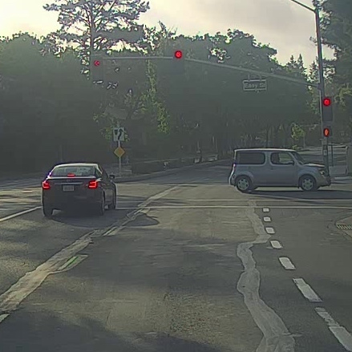
Image Classification Vs. Localization & Detection
Image classification
Classification with
localization
Detection

Slide 16
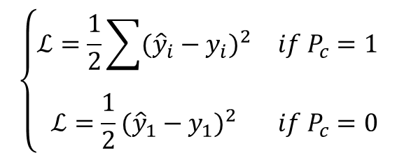

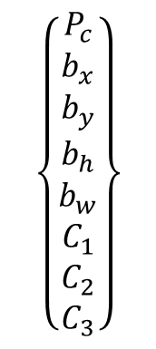

Image Localization & Detection
$$\left\{\begin{matrix}P_{c} \\ b_{x} \\ \begin{aligned}b_{y} \\ b_{h} \\ b_{w} \\ C_{1} \\ C_{2} \\ C_{3}\end{aligned}\end{matrix}\right\}$$
$$⋯$$
$$⋮$$
1 - pedestrian
$$\left\{\begin{matrix}ℒ=\frac{1}{2}\sum{{({\hat{y}}_{i}−y_{i})}^{2}} & if P_{c}=1 \\ ℒ=\frac{1}{2}{({\hat{y}}_{1}−y_{1})}^{2} & if P_{c}=0\end{matrix}\right.$$
2 - car
3 - motorcycle
4 - background
Notes:
Usually we use square error for the boxes and log likelihood for the classes, but here we simplify
The height and width are percentages (this way we can maintain relatively)

Slide 17
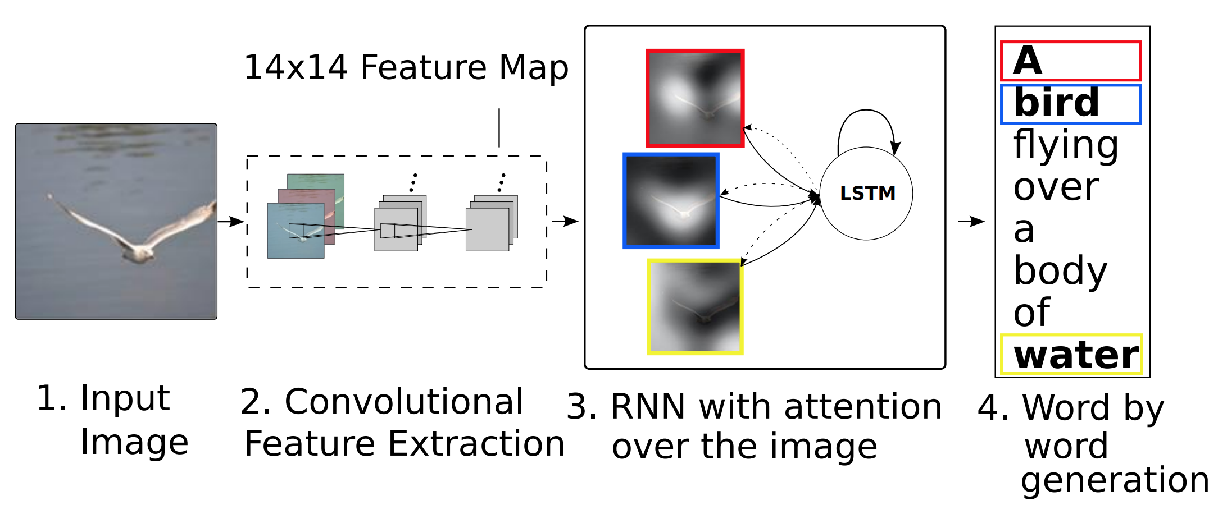
Attention Models in Images
This work automatically generates image captioning
[Xu et. al., 2015. Show, attend and tell: Neural image caption generation with visual attention]
Notes:
A very similar architecture can be used for image captioning, where the attention models are used to look at different parts of the image

Slide 18
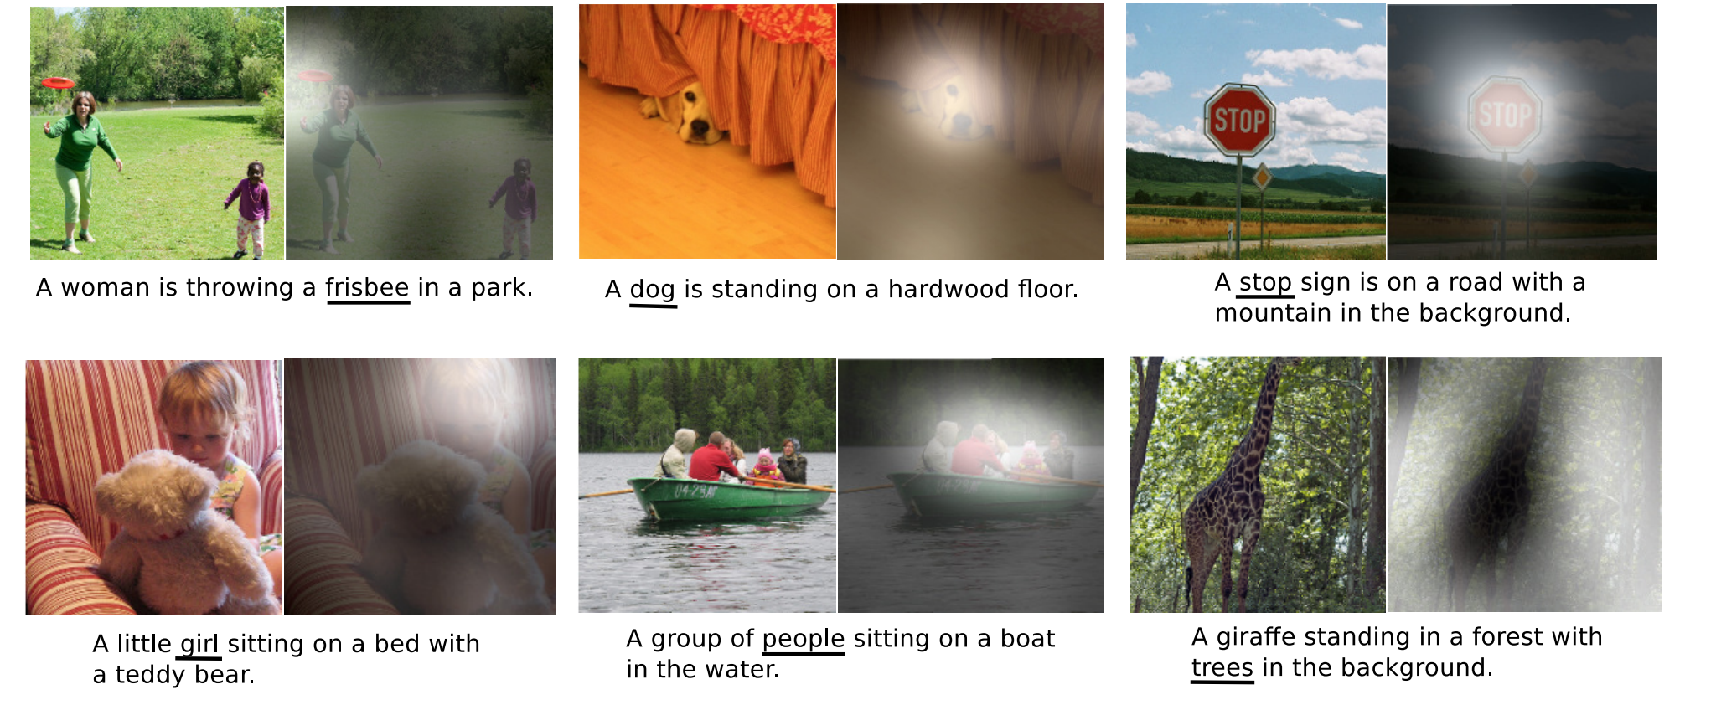
Attention Models in Images
Notes:
The right ones…

Slide 19
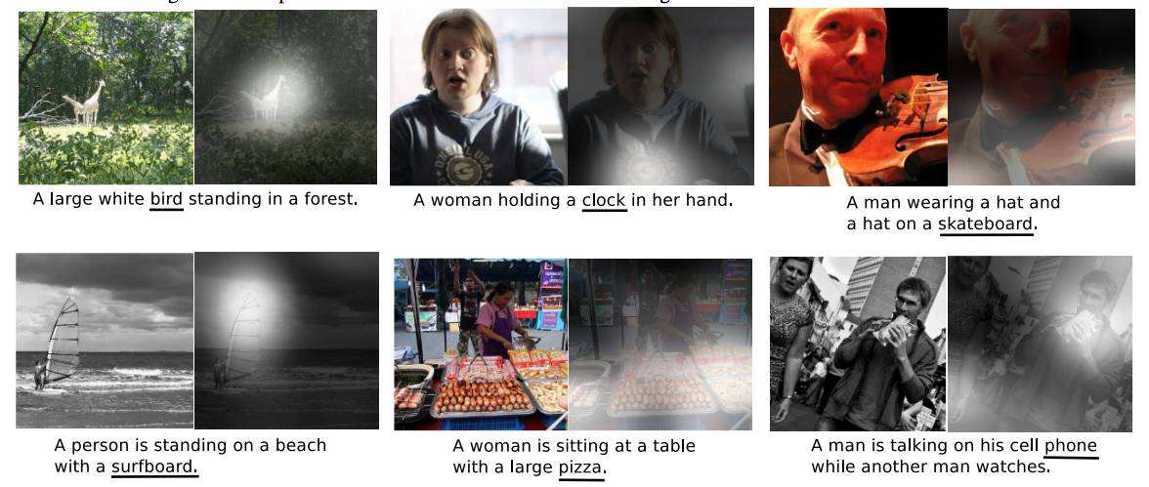
Attention Models in Images
Notes:
… and the mistakes

Slide 20
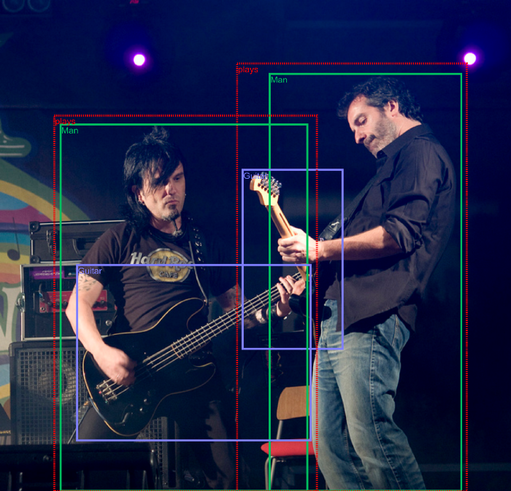
Visual Relationship Detection
Visual Relationship Detection is the ability to decipher what relationship does the two objects share.
For example, the relationship is “plays”, the subject is “man” and object is “guitar”.
Notes:
Source: https://medium.com/analytics-vidhya/beginners-guide-to-object-detection-algorithms-6620fb31c375

Slide 21
Visual Relationship Detection
In Computer Vision, usually a relationship is defined in the form of a triplet <Subject, Predicate, Object> .
So the picture below would be described as
<“man”, “plays”, “guitar”>.
Notes:
Source: https://medium.com/analytics-vidhya/beginners-guide-to-object-detection-algorithms-6620fb31c375

Slide 22
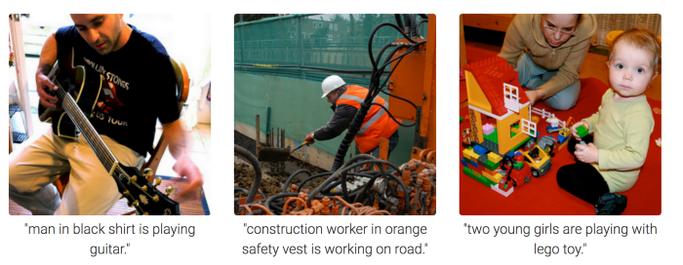
Image Captioning
Image Captioning is looking at an image and describing what is happening in the image.
The image given below contains annotations or labels which describe what is happening in the Image which should give you a good idea about what Image Captioning does.
Notes:
Source: https://medium.com/analytics-vidhya/beginners-guide-to-object-detection-algorithms-6620fb31c375

Slide 23


Image Reconstruction
Image Reconstruction or Image Inpainting is the ability to identify what is missing in an image in order to reconstruct it.
The image given below shows examples where parts of an image has been damaged for some reason and the task is to recreate and fill the image to reconstruct the original image.
Notes:
Source: https://medium.com/analytics-vidhya/beginners-guide-to-object-detection-algorithms-6620fb31c375

Slide 24
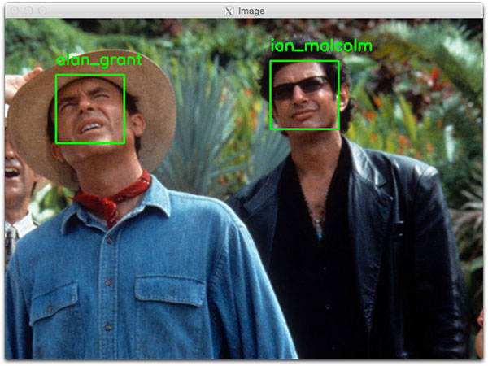
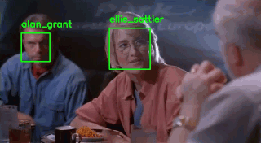
Face Recognition
Face Recognition is the capability to identify a person based on an image, video or live meet.
Notes:
https://www.pyimagesearch.com/2018/06/18/face-recognition-with-opencv-python-and-deep-learning/

Slide 25
Instance Segmentation
Instance Segmentation basically identify different instances given in the image with their boundaries intact.
The trained model tries to identify each object instance in the image and recognized their boundary at the deep pixel level.
Notes:
https://www.pyimagesearch.com/2018/06/18/face-recognition-with-opencv-python-and-deep-learning/

Slide 26
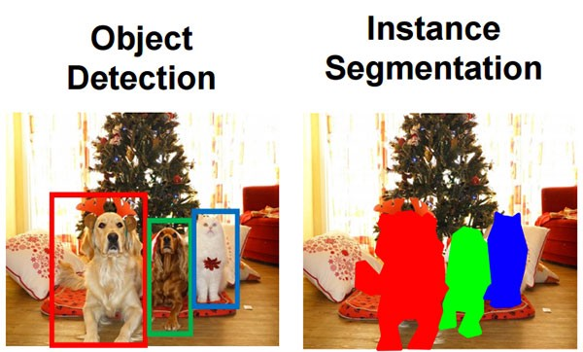
Instance Segmentation
What is the difference between object detection and instance segmentation?
Notes:
https://www.pyimagesearch.com/2018/06/18/face-recognition-with-opencv-python-and-deep-learning/

Slide 27
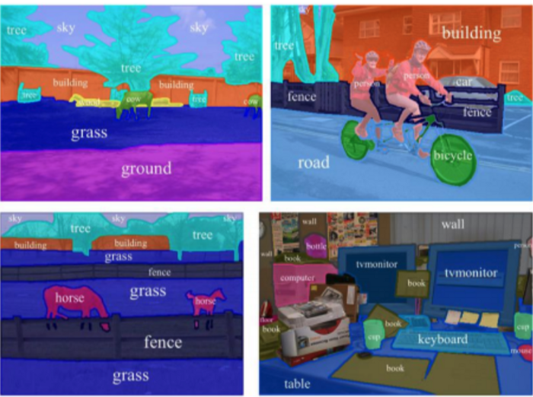
Semantic Segmentation
Semantic Segmentation basically tries to identify similar objects in the object which belong to the same class at the pixel level.
The model has tried to identify similar objects like trees, tires in the bicycle, grass, buildings, etc. and color coded them in same color to symbolize them belonging to same class.
Notes:
https://www.pyimagesearch.com/2018/06/18/face-recognition-with-opencv-python-and-deep-learning/

Slide 28
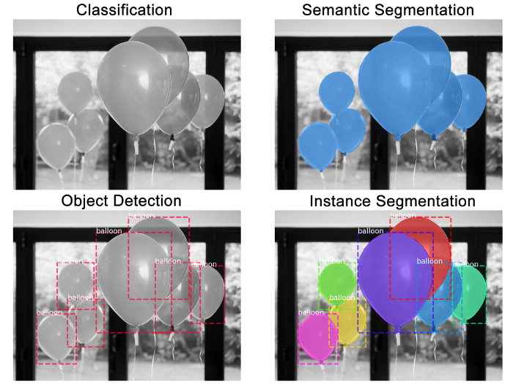
Confusion between different tasks
Many times we get confused between the concepts of Image Classification, Object Detection, Instance Segmentation and Semantic Segmentation.
Notes:
The picture below helps us understand the difference better.

Slide 29
AI imitates human capabilities
Search & Optimization
Computer vision
Reasoning Under Uncertainty
Natural language
processing
Robotics
Speech recognition
Planning
Autonomous Systems

Slide 30
Speech Recognition
Speech recognition, also known as
automatic speech recognition (ASR),
computer speech recognition, or
speech-to-text,
It is a capability which enables a program to process human speech into a written format.
Notes:
The picture below helps us understand the difference better.

Slide 31

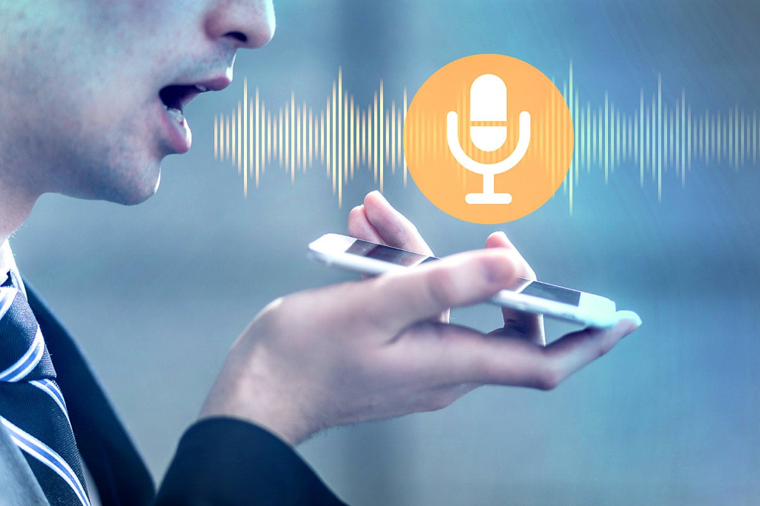
What is the difference between speech and voice recognition?
Speech recognition focuses on the translation of speech from a verbal format to a text one, whereas voice recognition just seeks to identify an individual user’s voice.
Notes:
The picture below helps us understand the difference better.

Slide 32
AI imitates human capabilities
Search & Optimization
Computer vision
Reasoning Under Uncertainty
Natural language
processing
Robotics
Speech recognition
Planning
Autonomous Systems

Slide 33
Reasoning Under Uncertainty
All of the time, agents are forced to make decisions based on incomplete information.
Even when an agent senses the world to find out more information, it rarely finds out the exact state of the world.
A robot does not know exactly where an object is.
A doctor does not know exactly what is wrong with a patient.
A teacher does not know exactly what a student understands.
When intelligent agents must make decisions, they have to use whatever information they have and utilize probabilities for make decisions.
Notes:
https://artint.info/html/ArtInt_138.html

Slide 34
AI imitates human capabilities
Search & Optimization
Computer vision
Reasoning Under Uncertainty
Natural language
processing
Robotics
Speech recognition
Planning
Autonomous Systems

Slide 35
Planning
AI Planning is a field of artificial intelligence which explores the process of using autonomous techniques to solve planning and scheduling problems.
A planning problem is one in which we have some initial starting state, which we wish to transform into a desired goal state through the application of a set of actions.
Notes:
https://artint.info/html/ArtInt_138.html

Slide 36
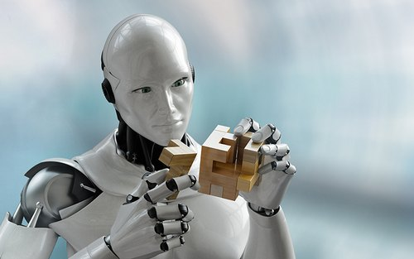
Planning
For example, imagine we wish to build a house.
On our building site, we can assume all the materials are ready to be used and we essentially now have to decide which order to perform construction in.
Each step of construction in this situation could be modelled as an action (e.g., laying foundations, building the walls, installing the plumbing, and electricals, etc.).
Certain actions cannot happen before others - we cannot build a wall before we have a foundation - so through the use of predicate logic we can express this problem by saying “if there is no foundation, we cannot build a wall”.
Notes:
https://planning.wiki/guide/whatis/aip

Slide 37
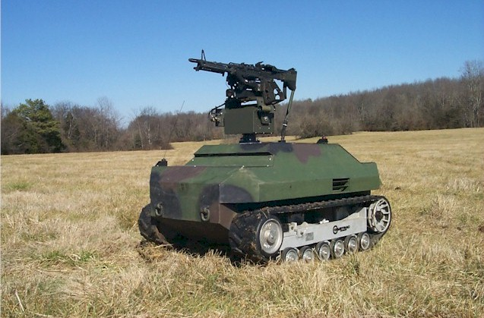
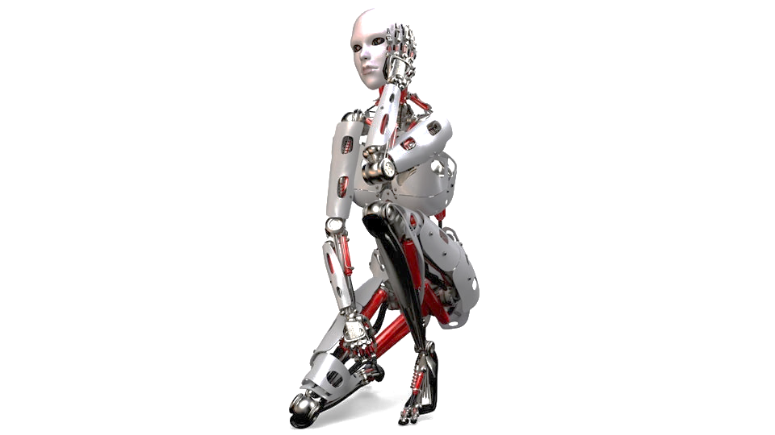

Planning
AI planning is a branch of artificial intelligence that concerns the realization of strategies or action sequences, typically for execution by
intelligent agents,
autonomous robots, and
unmanned vehicles.
Notes:
https://planning.wiki/guide/whatis/aip

Slide 38

Planning
Which famous application utilizes AI planning to optimize driving by detecting the shortest path from one point to another?
Notes:
https://planning.wiki/guide/whatis/aip

Slide 39
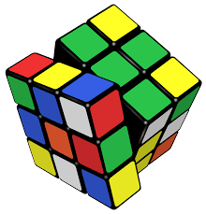
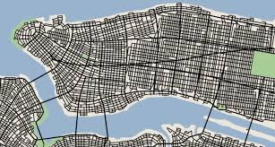
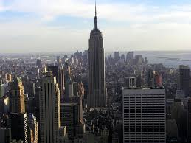
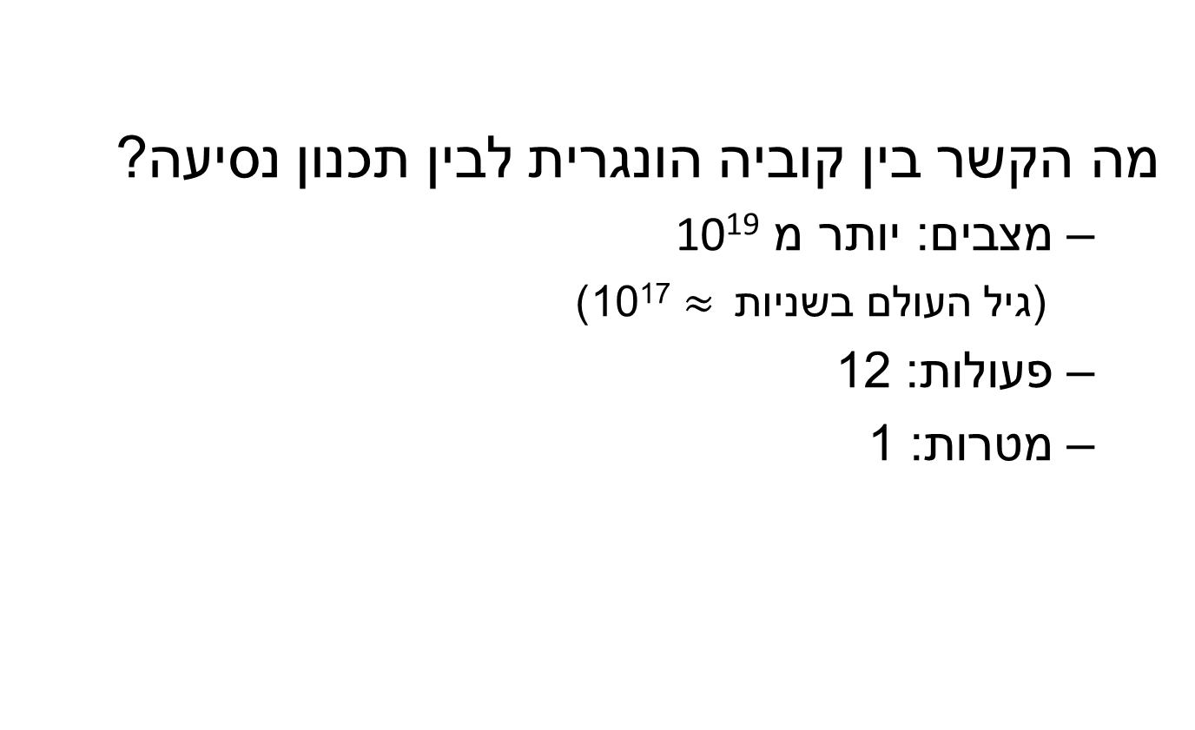
Pathfinding
מה הקשר בין קוביה הונגרית לבין תכנון נסיעה?
מצבים: יותר מ 10¹⁹
(גיל העולם בשניות $≈$ 10¹⁷)
פעולות: 12
מטרות: 1
start
end

Slide 40
AI imitates human capabilities
Search & Optimization
Computer vision
Reasoning Under Uncertainty
Natural language
processing
Robotics
Speech recognition
Planning
Autonomous Systems

Slide 41
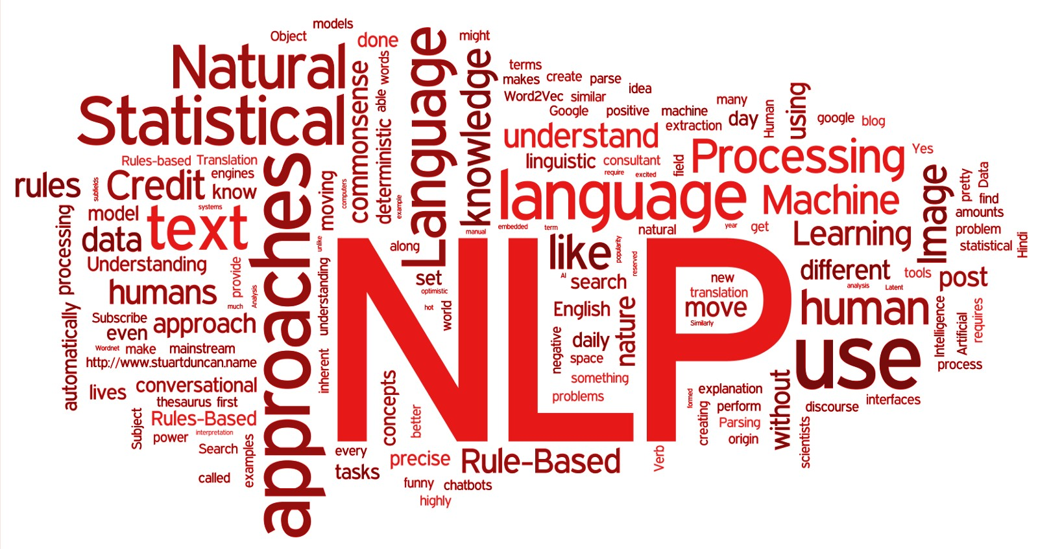
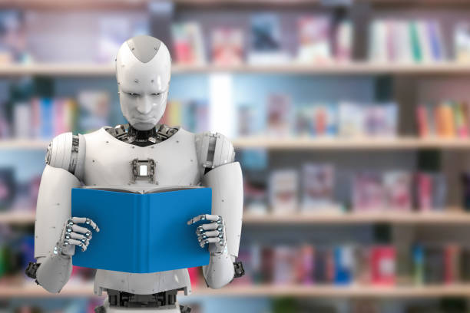
Natural language processing
Natural language processing (NLP) is a subfield of
linguistics,
computer science, and
artificial intelligence
It concerned with the interactions between computers and human language, in particular how to program computers to process and analyze large amounts of natural language data.
Notes:
https://www.avenga.com/magazine/natural-language-processing-application-areas/

Slide 42
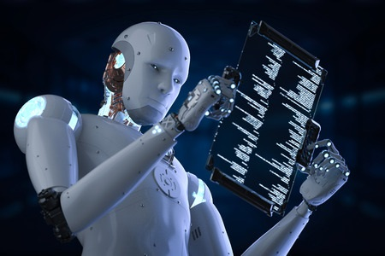
Natural language processing
The goal is a computer capable of "understanding" the contents of documents, including the contextual nuances of the language within them.
The technology can then accurately extract information and insights contained in the documents, as well as categorize, and organize the documents themselves.
Notes:
https://www.avenga.com/magazine/natural-language-processing-application-areas/

Slide 43
Key application areas of NLP
Searching
Machine Translation
Text Summarization
Named-Entity Recognition
Parts-of-Speech tagging (POS)
Information Retrieval
Information Grouping
Sentiment Analysis
Answering Queries
Automated speech recognition (ASR)
Notes:
https://www.avenga.com/magazine/natural-language-processing-application-areas/

Slide 44
Key application areas of NLP
Searching
Machine Translation
Text Summarization
Named-Entity Recognition
Parts-of-Speech tagging (POS)
Information Retrieval
Information Grouping
Sentiment Analysis
Answering Queries
Automated speech recognition (ASR)
Notes:
https://www.avenga.com/magazine/natural-language-processing-application-areas/

Slide 45
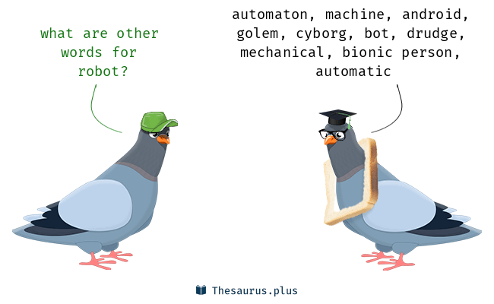
Searching
Searching - NLP algorithms identify specific elements in the text.
You can:
search for keywords in a document,
run a contextual search for synonyms,
detect misspelled words, or similar entries and more.
Notes:
https://www.avenga.com/magazine/natural-language-processing-application-areas/

Slide 46
Searching
Examples for a searching task:
Aviad Elyashar, Rami Puzis, and Michael Fire, ”It Runs in the Family: Unsupervised Algorithm for Alternative Name Suggestion Using Digitized Family Trees,” IEEE Transactions on Knowledge and Data Engineering Journal, 2021
Aviad Elyashar, Rami Puzis, and Michael Fire, ”How does that name sound? Name representation learning using accent-specific speech generation,” Knowledge-Based Systems Journal, Volume 227, 2021
Notes:
https://www.avenga.com/magazine/natural-language-processing-application-areas/

Slide 47
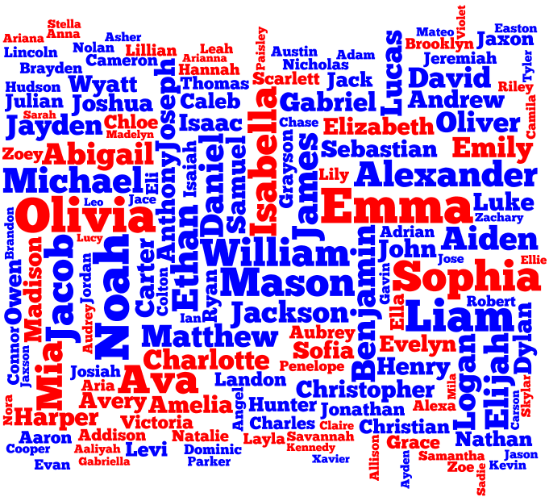
Searching for people by their names
Notes:
https://www.avenga.com/magazine/natural-language-processing-application-areas/

Slide 48




Searching for people by their names
Searching for a person’s name is a typical online activity on the Web or on databases.
Notes:
Retrieving a paper or news article by its author’s name, examining patient records or finding usernames via given emails are all daily activities carried out using individuals’ names.
Moreover, the dependency on names for searching on the web is consistently growing. In 2004, 30% of search engine queries included personal names .
One decade later, one billion names were entered in the Google search engine every day [6]

Slide 49



Searching for people by their names
However, Web search engines provide few accurate results to queries containing names.
Notes:
https://www.avenga.com/magazine/natural-language-processing-application-areas/

Slide 50
Searching for people by their names
In contrast to a general word with only one correct spelling, there are several possible legitimate spellings when a name is provided as a query.
For example, there are more than 40 variations of Amelia:
Aemelia
Amalia
Victor
Aimiliona
Amalie
Viktor
Amalea
Emma
Amalee
Emelie
Notes:
https://www.avenga.com/magazine/natural-language-processing-application-areas/

Slide 51
Searching for people by their names
Today, most techniques used to suggest diminutives and alternative spellings in online search are based on pattern matching and phonetic encoding; however, they often perform poorly.
As a result, there is a need for an effective tool for improved alternative name suggestion for a name provided as a query name.
Notes:
https://www.avenga.com/magazine/natural-language-processing-application-areas/

Slide 52
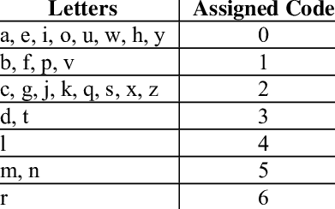
Phonetic Encoding Algorithms
Soundex(“Robert”) = R163
Notes:
Then, we developed a novel algorithm that can utilize the names existing in a graph to suggest similar names for a given name. We show that our general algorithm provides significantly superior results compared to other existing methods that focus on encoding or detection of specific patterns.

Slide 53
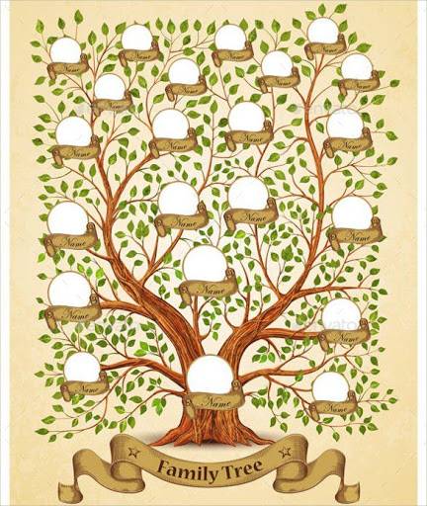
Searching for people by their names(solution1)
We collected data from a genealogy website
We constructed digitized family trees based on the collected data
We constructed a large weighted graph of first names, which contains information about how names have evolved over the centuries.
Notes:
https://www.avenga.com/magazine/natural-language-processing-application-areas/

Slide 54
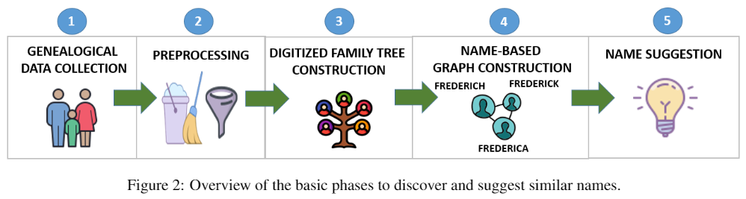
Suggesting Related Names Based on a Name-Based Graph
Notes:
Then, we developed a novel algorithm that can utilize the names existing in a graph to suggest similar names for a given name. We show that our general algorithm provides significantly superior results compared to other existing methods that focus on encoding or detection of specific patterns.

Slide 55
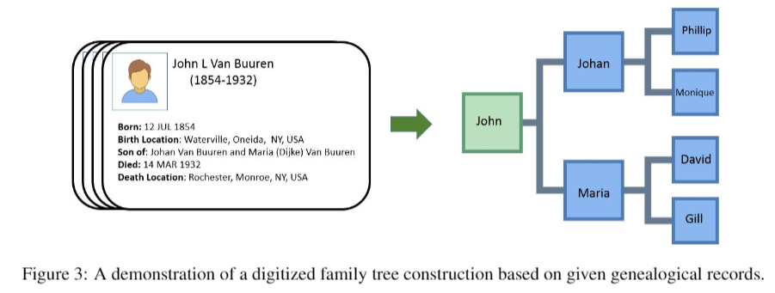
Constructing Digitized Family Trees
Notes:
Then, we developed a novel algorithm that can utilize the names existing in a graph to suggest similar names for a given name. We show that our general algorithm provides significantly superior results compared to other existing methods that focus on encoding or detection of specific patterns.

Slide 56
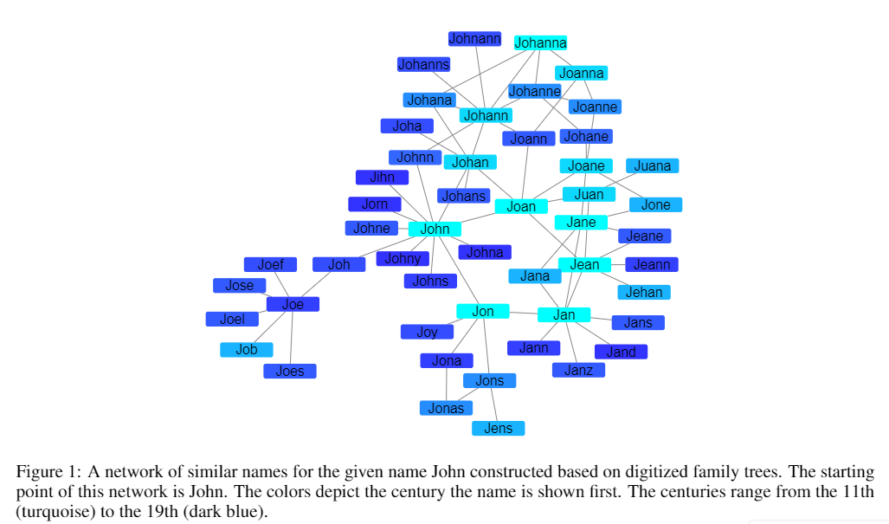
Searching for people by their names(solution1)
Notes:
https://www.avenga.com/magazine/natural-language-processing-application-areas/

Slide 57
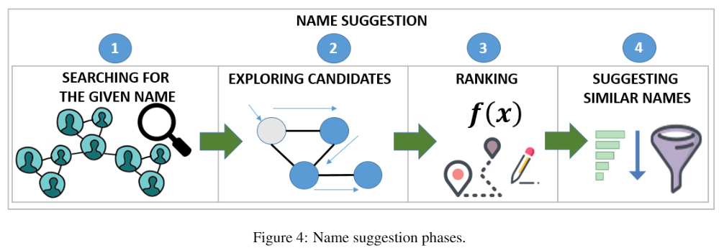
Name Suggestion
Notes:
Then, we developed a novel algorithm that can utilize the names existing in a graph to suggest similar names for a given name. We show that our general algorithm provides significantly superior results compared to other existing methods that focus on encoding or detection of specific patterns.

Slide 58


Searching for people by their names(solution2)
This AI approach utilizes automated speech generation and artificial neural networks to create advanced name representations.
The continuous vector space representation for names is based on the way humans pronounce names in any language, with any accent (e.g., American, and British English).
Notes:
https://www.avenga.com/magazine/natural-language-processing-application-areas/

Slide 59
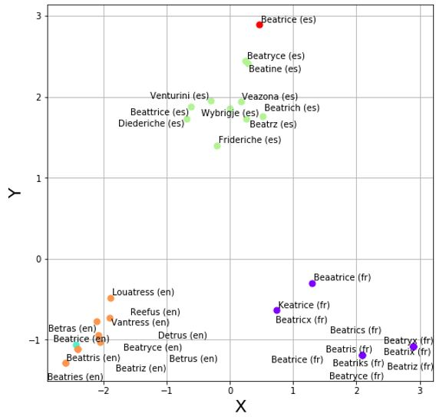
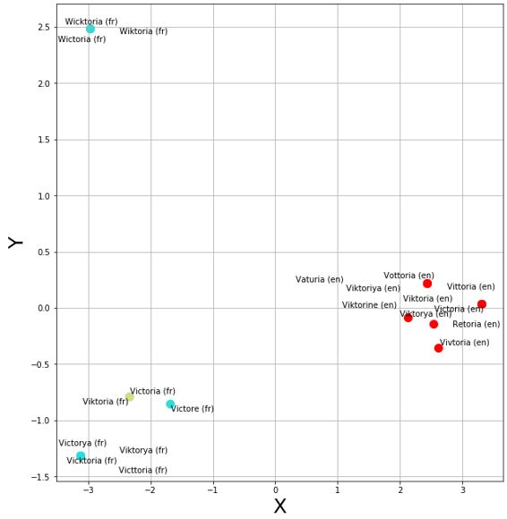
Searching for people by their names(solution2)
Notes:
https://www.avenga.com/magazine/natural-language-processing-application-areas/

Slide 60


Searching for people by their names(solutions)
Demonstration:
https://rps.ise.bgu.ac.il/naime
Notes:
https://www.avenga.com/magazine/natural-language-processing-application-areas/

Slide 61
Key application areas of NLP
Searching
Machine Translation
Text Summarization
Named-Entity Recognition
Parts-of-Speech tagging (POS)
Information Retrieval
Information Grouping
Sentiment Analysis
Emotion Detection
Answering Queries
Topic Detection
Notes:
https://www.avenga.com/magazine/natural-language-processing-application-areas/

Slide 62

Machine Translation
This typically involves translating one natural language into another, preserving the meaning and producing fluent text as a result. Different methods and approaches are used here:
rule-based,
Statistical, and
neural machine translation.
Notes:
https://www.avenga.com/magazine/natural-language-processing-application-areas/

Slide 63
Machine Translation
Given sentence: “Jane visite l’Afrique en septembre.”
Options for translation (required to find the most likely translation)
Jane is visiting Africa in September.
Jane is going to be visiting Africa in September.
In September, Jane will visit Africa.
Her African friend welcomed Jane in September.
Notes:
https://www.avenga.com/magazine/natural-language-processing-application-areas/

Slide 64
Key application areas of NLP
Searching
Machine Translation
Text Summarization
Named-Entity Recognition
Parts-of-Speech tagging (POS)
Information Retrieval
Information Grouping
Sentiment Analysis
Answering Queries
Automated speech recognition (ASR)
Notes:
https://www.avenga.com/magazine/natural-language-processing-application-areas/

Slide 65
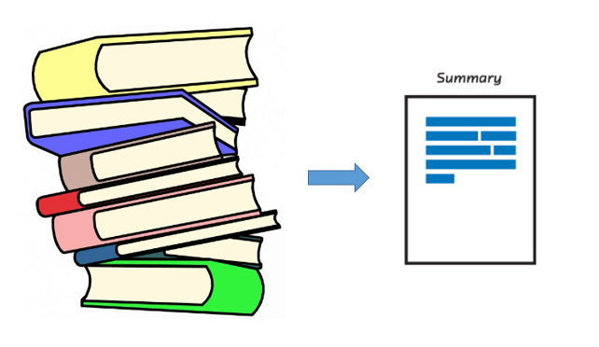
Text Summarization
NLP algorithms can be used to create a shortened version of an article, document, number of entries, etc., with main points and key ideas included.
There are two general approaches:
abstractive summarization, and
extractive summarization.
In the first case, the NLP model creates an entirely new summary in terms of phrases and sentences used in the analyzed text.
In the second case, the model extracts phrases and sentences from the existing text and groups them into a summary.
Notes:
https://www.avenga.com/magazine/natural-language-processing-application-areas/

Slide 66
Key application areas of NLP
Searching
Machine Translation
Text Summarization
Named-Entity Recognition
Parts-of-Speech tagging (POS)
Information Retrieval
Information Grouping
Sentiment Analysis
Answering Queries
Automated speech recognition (ASR)
Notes:
https://www.avenga.com/magazine/natural-language-processing-application-areas/

Slide 67
Named-Entity Recognition
Named-Entity Recognition (NER) is an entity extraction, identification and categorization.
It involves extracting names of locations, people and things from the text and placing them under certain categories – Person, Company, Time, Location, etc.
The use cases may include content classification for:
search engine optimization (SEO),
customer support,
patient lab reports analysis,
academic research and others.
Notes:
https://www.avenga.com/magazine/natural-language-processing-application-areas/

Slide 68
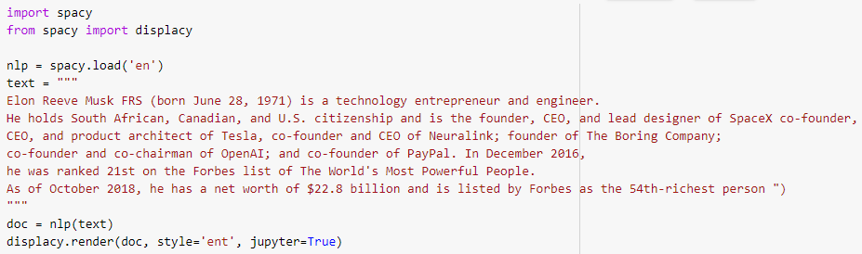
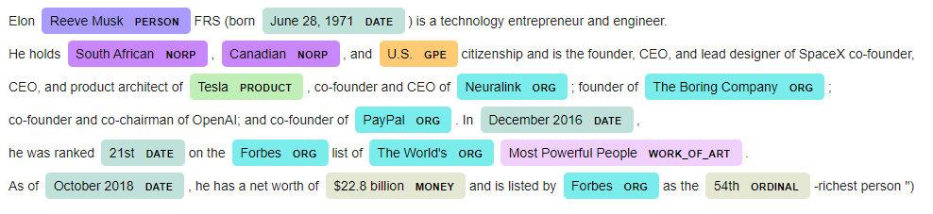
Named-Entity Recognition (Demonstration)
Notes:
https://www.avenga.com/magazine/natural-language-processing-application-areas/

Slide 69
Key application areas of NLP
Searching
Machine Translation
Text Summarization
Named-Entity Recognition
Parts-of-Speech (POS) tagging
Information Retrieval
Information Grouping
Sentiment Analysis
Answering Queries
Automated speech recognition (ASR)
Notes:
https://www.avenga.com/magazine/natural-language-processing-application-areas/

Slide 70

Parts-of-Speech (POS) tagging
It groups words from the text according to parts of speech based on word definition and context.
POS tagging methods and models include lexical-based, rule-based, probabilistic methods, as well as the use of recurrent neural networks and more.
Notes:
https://www.freecodecamp.org/news/an-introduction-to-part-of-speech-tagging-and-the-hidden-markov-model-953d45338f24/

Slide 71
Key application areas of NLP
Searching
Machine Translation
Text Summarization
Named-Entity Recognition
Parts-of-Speech (POS) tagging
Information Retrieval
Information Grouping
Sentiment Analysis
Answering Queries
Automated speech recognition (ASR)
Notes:
https://www.avenga.com/magazine/natural-language-processing-application-areas/

Slide 72

Information Retrieval
With the help of NLP, we can find the needed piece among unstructured data.
An information retrieval system indexes a collection of documents, analyzes the user’s query, then compares each document’s description with the query and presents the relevant results.
Notes:
https://www.freecodecamp.org/news/an-introduction-to-part-of-speech-tagging-and-the-hidden-markov-model-953d45338f24/

Slide 73


Fake News Data Collection and Classification:
Iterative Query Selection for Opaque Search Engines with Pseudo Relevance Feedback

Slide 74


INTRODUCTION
Notes:
Every day, millions of people search for information online.
Market researchers search for products related to their product or business [2]. Researchers reviewing the academic literature search for works
related to their current article [3]. Posts and comments that discuss a news item are retrieved from online
social media (OSM) for fake news detection [4].
There are many similar cases when additional information related to a specific document is required. We will refer to such a document as a prototype
.

Slide 75



INTRODUCTION
In this paper, we focus on the problem of retrieving documents that are most similar to a given prototype document from an opaque search engine supporting short keyword queries, such as Twitter.
Notes:
Retrieval methods that are based on document similarity assume access to the corpus being searched.
This assumption is valid for transparent search engines, where the repository and the algorithms are known to the user. However, all the popular search engines, including general purpose search like Google, or platform specific, such as Twitter search, are opaque providing very little information about their repositories and
algorithms [9]. Other than Google’s image search, current search engines do not provide document-based search services.
It is possible to manually formulate a search query from the document’s content [4]. But of course, manual query selection does not scale. We can use the prototype document’s title to generate queries [14], or search for its URL if the prototype is a web page [15].
However, these approaches miss many relevant results

Slide 76








METHOD
Here, we suggest a novel iterative approach that selects queries that maximize the number of retrieved relevant results, using limited interaction with an opaque search engine.
Short
Document

Slide 77
METHOD
This approach consists of two components:
the Iterative Query Selection (IQS) algorithm and
Mean Relevance Error (MRE) score.
The IQS is a hill climbing algorithm that iteratively optimizes short keyword queries given a prototype document.
The MRE is used as pseudo relevance feedback, by ranking the results of incumbent queries generated by IQS according to their relevance to the prototype document.

Slide 78



MEAN RELEVANCE ERROR (MRE)
Prototype
Document
Irrelevant
Tweet
Notes:
The MRE relies on semantic word embedding, also known as a low dimensional vector representation of words. Intuitively, the MRE quantifies the similarity between the words used in the prototype document and in a retrieved result.
There are many word embedding methods, such as GloVe [34], Word2Vec [35], fastText [36], etc. We can use any word embedding method, where words with a similar meaning are embedded close to each other.

Slide 79

MEAN RELEVANCE ERROR (MRE)
Notes:
The MRE relies on semantic word embedding, also known as a low dimensional vector representation of words. Intuitively, the MRE quantifies the similarity between the words used in the prototype document and in a retrieved result.
There are many word embedding methods, such as GloVe [34], Word2Vec [35], fastText [36], etc. We can use any word embedding method, where words with a similar meaning are embedded close to each other.

Slide 80
Key application areas of NLP
Searching
Machine Translation
Text Summarization
Named-Entity Recognition
Parts-of-Speech (POS) tagging
Information Retrieval
Information Grouping
Sentiment Analysis
Answering Queries
Automated speech recognition (ASR)
Notes:
https://www.avenga.com/magazine/natural-language-processing-application-areas/

Slide 81

Information Grouping
Grouping, or text classification, is performed via the text tags.
The NLP model is trained to classify documents according to specific attributes: subject, document type, time, author, language, etc.
Text classification usually requires labeled data.
Information grouping is used for supervised machine learning, which correspondingly triggers a multitude of use cases.
Notes:
https://www.freecodecamp.org/news/an-introduction-to-part-of-speech-tagging-and-the-hidden-markov-model-953d45338f24/

Slide 82
Key application areas of NLP
Searching
Machine Translation
Text Summarization
Named-Entity Recognition
Parts-of-Speech (POS) tagging
Information Retrieval
Information Grouping
Sentiment Analysis
Answering Queries
Automated speech recognition (ASR)
Notes:
https://www.avenga.com/magazine/natural-language-processing-application-areas/

Slide 83

Sentiment Analysis
It’s a type of text classification where the NLP algorithms determine the text’s positive, negative, or neutral connotation.
Use cases include:
analyzing customers’ feedback,
detecting trends,
conducting market research, etc.,
via an analysis of tweets, posts, reviews and other reactions.
Notes:
https://www.freecodecamp.org/news/an-introduction-to-part-of-speech-tagging-and-the-hidden-markov-model-953d45338f24/

Slide 84

Sentiment Analysis
Sentiment analysis can encompass everything from the release of a new game on the App Store to political speeches and regulation changes.
Notes:
https://www.freecodecamp.org/news/an-introduction-to-part-of-speech-tagging-and-the-hidden-markov-model-953d45338f24/

Slide 85
Key application areas of NLP
Searching
Machine Translation
Text Summarization
Named-Entity Recognition
Parts-of-Speech (POS) tagging
Information Retrieval
Information Grouping
Sentiment Analysis
Emotion Detection
Answering Queries
Topic Analysis
Notes:
https://www.avenga.com/magazine/natural-language-processing-application-areas/

Slide 86

What is the difference between sentiment analysis and emotion detection?
Sentiment analysis focuses on three basic sentiments:
Positive
Negative
Neutral
Emotion detection utilize the given text in order to detect Ekman’s six basic emotions:
sadness,
happiness,
anger,
fear,
disgust, and
surprise
Notes:
https://www.freecodecamp.org/news/an-introduction-to-part-of-speech-tagging-and-the-hidden-markov-model-953d45338f24/

Slide 87

Question Answering
An automated question answering system applies a set of NLP techniques to analyze unstructured documents – from Wikipedia articles to social media newsfeed or medical records – by retrieving the needed information piece, analyzing it and using the best part to answer the question.
Notes:
https://www.machinecurve.com/index.php/2020/12/21/easy-question-answering-with-machine-learning-and-huggingface-transformers/

Slide 88
Topic Detection
Topic detection, also known as topic modelling is a statistical model for discovering abstract "topics" that occur in a collection of documents.
Topic model algorithms are used to discover hidden subjects in a large collection of unstructured texts.
Notes:
https://www.analyticsvidhya.com/blog/2021/05/topic-modelling-in-natural-language-processing/

Slide 89

Topic Detection (Demonstration)
Aviad Elyashar, Ilia Plochotnikov, Idan-Chaim Cohen, Rami Puzis, and Odeya Cohen, “The State of Mind of Healthcare Professionals in the Light of the COVID-19: Insights from Text Analysis of Twitter’s Online Discourses,” Journal Of Medical Internet Research (JMIR), 2021.
Notes:
https://www.analyticsvidhya.com/blog/2021/05/topic-modelling-in-natural-language-processing/

Slide 90

State of Mind of Healthcare Professionals in Social Media during COVID-19
Notes:
Here, we demonstrated a use case of a targeted data collection from a specific population.
In this case, healthcare professionals during the COVID-19 pandemic.
https://www.agilitypr.com/pr-news/public-relations/3-critical-pr-skills-that-all-healthcare-professionals-must-have-today/

Slide 91

Introduction
The COVID-19 pandemic has affected populations worldwide, with extreme health, economic, social, and political implications.
Healthcare professionals (HCPs) are at the core of pandemic response and are among the most crucial factors in maintaining coping capacities.

Slide 92

Problems
Yet, they are also vulnerable to
mental health effects,
managing a long-lasting emergency under lack of resources and
complicated personal concerns.
There is a lack of longitudinal studies that investigate the HCP population.
Notes:
https://www.ruralhealthinfo.org/rural-monitor/healthcare-professionals-mental-health/

Slide 93
Related Work
Analysis of online discourse sentiment and general dynamics
Longitudinal vs. short-term early stages [1-9]
Post collection
Population-targeted classifiers vs. pre-defined keywords and hashtags [5, 7, 8]
Study population
HCPs and difficulties in identifying them as a study population [6, 10]
Notes:
Methodological Aspects-
Reported case number prediction
Analysis of online discourse, sentiment and general dynamics
All of these [3, 25, 26, 27, 28, 29, 30, 31, 32] studies used posts published in the early stages of the pandemic, unlike our work
which analyses a single year with comparison in the emotional dimension with the year before the pandemic
Most studies collected posts using predefined keywords or hashtags [28, 30, 31] – our classifiers assisted in collecting posts much more specific to the healthcare professional population
Only a few studies focus on HCPs [8, 29] – could be explained by the difficulties in identifying HCPs as a study population

Slide 94
Goal
To analyze the state of mind of HCPs, in light of COVID-19, as expressed in online discussions published on Twitter, from 2019 until the end of 2020.

Slide 95

Methodology
Notes:
Two of our teammates who are healthcare experts defined a list of general medical professions and specializations recognized by the American Board of Medical Specialties (Figure 1.1).
Second, a list of points of interest (POI) types, such as unions, conferences, and journals, were defined (Step 1).
In addition, we added countries and regions related to English speakers.
We created short keyword queries by taking one keyword from each list, for example, immunology journal or family medicine England (Step 2).
We used the Twitter search engine to collect accounts matching the short keyword queries (Step 3).
The results were manually inspected to identify accounts managed by facilities, organizations, and venues related to healthcare.
The resulting 563 accounts which are were divided into four groups of medical professions and the fifth group of general healthcare interest.
We removed from this list 41 POIs that are likely to be followed by non-HCP.
Using the Twitter API, we collected 434,825 followers of the remaining 522 HCP POIs prioritizing those that follow multiple POIs.
Twitter accounts collected in this manner include private accounts, and accounts managed by organizations, for example, official accounts of medical centers in the U.S.
There are also many non-HCP accounts, for example, patients, reporters, or academic scholars.
Using the Twitter API, we collected 434,825 followers of the remaining 522 HCP POIsprioritizing those that follow multiple POIs. Twitter accounts collected in this mannerinclude private accounts, and accounts managed by organizations, for example, officialaccounts of medical centers in the U.S. There are also many non-HCP accounts, forexample, patients, reporters, or academic scholars.

Slide 96

Methodology
Notes:
Two of our teammates who are healthcare experts defined a list of general medical professions and specializations recognized by the American Board of Medical Specialties (as can be seen in Table 3 List 1).
Second, a list of points of interest (POI) types, such as unions, conferences, and journals, were defined (see List 2).
In addition, we added countries and regions related to English speakers.

Slide 97
Methodology
Notes:
Two of our teammates who are healthcare experts defined a list of general medical professions and specializations recognized by the American Board of Medical Specialties (Figure 1.1).
Second, a list of points of interest (POI) types, such as unions, conferences, and journals, were defined (Step 1).
In addition, we added countries and regions related to English speakers.
We created short keyword queries by taking one keyword from each list, for example, immunology journal or family medicine England (Step 2).
We used the Twitter search engine to collect accounts matching the short keyword queries (Step 3).
The results were manually inspected to identify accounts managed by facilities, organizations, and venues related to healthcare.
The resulting 563 accounts which are were divided into four groups of medical professions and the fifth group of general healthcare interest.
We removed from this list 41 POIs that are likely to be followed by non-HCP.
Using the Twitter API, we collected 434,825 followers of the remaining 522 HCP POIs prioritizing those that follow multiple POIs.
Twitter accounts collected in this manner include private accounts, and accounts managed by organizations, for example, official accounts of medical centers in the U.S.
There are also many non-HCP accounts, for example, patients, reporters, or academic scholars.
Using the Twitter API, we collected 434,825 followers of the remaining 522 HCP POIsprioritizing those that follow multiple POIs. Twitter accounts collected in this mannerinclude private accounts, and accounts managed by organizations, for example, officialaccounts of medical centers in the U.S. There are also many non-HCP accounts, forexample, patients, reporters, or academic scholars.

Slide 98
Short keyword queries
We created short keyword queries by taking one keyword from each list.
For example,
immunology journal or family medicine England.

Slide 99
Methodology
Notes:
We used the Twitter search engine to collect accounts matching the short keyword queries (Step 3).
The results were manually inspected to identify accounts managed by facilities, organizations, and venues related to healthcare.
The resulting 563 accounts which are were divided into four groups of medical professions and the fifth group of general healthcare interest.
We removed from this list 41 POIs that are likely to be followed by non-HCP.
Using the Twitter API, we collected 434,825 followers of the remaining 522 HCP POIs prioritizing those that follow multiple POIs.
Twitter accounts collected in this manner include private accounts, and accounts managed by organizations, for example, official accounts of medical centers in the U.S.
There are also many non-HCP accounts, for example, patients, reporters, or academic scholars.
Using the Twitter API, we collected 434,825 followers of the remaining 522 HCP POIsprioritizing those that follow multiple POIs. Twitter accounts collected in this mannerinclude private accounts, and accounts managed by organizations, for example, officialaccounts of medical centers in the U.S. There are also many non-HCP accounts, forexample, patients, reporters, or academic scholars.

Slide 100
HCP points of interest in Twitter
We used the Twitter search engine to collect accounts matching the short keyword queries.
The results were manually inspected to identify accounts managed by facilities, organizations, and venues related to healthcare.
The resulting 563 accounts which are were divided into four groups of medical professions and the fifth group of general healthcare interest.
We removed from this list POIs that are likely to be followed by non-HCP.
Notes:
We removed from this list 41 POIs that are likely to be followed by non-HCP.

Slide 101
Methodology
Notes:
We used the Twitter search engine to collect accounts matching the short keyword queries (Step 3).
The results were manually inspected to identify accounts managed by facilities, organizations, and venues related to healthcare.
The resulting 563 accounts which are were divided into four groups of medical professions and the fifth group of general healthcare interest.
We removed from this list 41 POIs that are likely to be followed by non-HCP.
Using the Twitter API, we collected 434,825 followers of the remaining 522 HCP POIs prioritizing those that follow multiple POIs.
Twitter accounts collected in this manner include private accounts, and accounts managed by organizations, for example, official accounts of medical centers in the U.S.
There are also many non-HCP accounts, for example, patients, reporters, or academic scholars.
Using the Twitter API, we collected 434,825 followers of the remaining 522 HCP POIsprioritizing those that follow multiple POIs. Twitter accounts collected in this mannerinclude private accounts, and accounts managed by organizations, for example, officialaccounts of medical centers in the U.S. There are also many non-HCP accounts, forexample, patients, reporters, or academic scholars.

Slide 102
HCP related Twitter Accounts
Using the Twitter API, we collected 434,825 followers of the remaining 522 HCP POIs prioritizing those that follow multiple POIs.
Twitter accounts collected in this manner include private accounts, and accounts managed by organizations, for example, official accounts of medical centers in the U.S.
There are also many non-HCP accounts, for example, patients, reporters, or academic scholars.
Notes:
I won’t talk how did we defined HCPs due to limited time.

Slide 103
Methodology
Notes:
We used the Twitter search engine to collect accounts matching the short keyword queries (Step 3).
The results were manually inspected to identify accounts managed by facilities, organizations, and venues related to healthcare.
The resulting 563 accounts which are were divided into four groups of medical professions and the fifth group of general healthcare interest.
We removed from this list 41 POIs that are likely to be followed by non-HCP.
Using the Twitter API, we collected 434,825 followers of the remaining 522 HCP POIs prioritizing those that follow multiple POIs.
Twitter accounts collected in this manner include private accounts, and accounts managed by organizations, for example, official accounts of medical centers in the U.S.
There are also many non-HCP accounts, for example, patients, reporters, or academic scholars.
Using the Twitter API, we collected 434,825 followers of the remaining 522 HCP POIsprioritizing those that follow multiple POIs. Twitter accounts collected in this mannerinclude private accounts, and accounts managed by organizations, for example, officialaccounts of medical centers in the U.S. There are also many non-HCP accounts, forexample, patients, reporters, or academic scholars.

Slide 104



Training machine learning classifiers using active learning
To filter out organizational and non-HCP Twitter accounts, we trained two machine learning classifiers through an iterative process known as active learning.
Here, we used the SVM (support vector machine) classification model.
TF-IDF (term frequency-inverse document frequency) features were extracted from the accounts’ description and full name.
The latter occasionally include a profession or a relevant title, such as MD (medical doctor) or RN (registered nurse)

Slide 105
Training machine learning classifiers
Building Individual vs Organization and HCP vs Not HCP classifiers
1,800 accounts following point-of-interest health, three reviewers, 20 iterations
Each account was examined by two reviewers separately
Account description and tweets for assessment
Individuals – HCP or not HCP?
Disagreements settled to consensus in a meeting of the three reviewers

Slide 106

Classifiers’ Performance
Individual vs. Organization – 88.5% accuracy 10XCV
HCP classifier on Individual accounts – 78.6% accuracy 10XCV
70+% confidence instances considered individual HCPs
53K authors – 16.6M tweets from 01.01.2019 to 06.12.2020
Random test sample 1 (N=100) – 84% of accounts are individual HCPs
Random test sample 2 (N=100) – 89% of accounts are individual HCPs

Slide 107
Methodology
Notes:
We used the Twitter search engine to collect accounts matching the short keyword queries (Step 3).
The results were manually inspected to identify accounts managed by facilities, organizations, and venues related to healthcare.
The resulting 563 accounts which are were divided into four groups of medical professions and the fifth group of general healthcare interest.
We removed from this list 41 POIs that are likely to be followed by non-HCP.
Using the Twitter API, we collected 434,825 followers of the remaining 522 HCP POIs prioritizing those that follow multiple POIs.
Twitter accounts collected in this manner include private accounts, and accounts managed by organizations, for example, official accounts of medical centers in the U.S.
There are also many non-HCP accounts, for example, patients, reporters, or academic scholars.
Using the Twitter API, we collected 434,825 followers of the remaining 522 HCP POIsprioritizing those that follow multiple POIs. Twitter accounts collected in this mannerinclude private accounts, and accounts managed by organizations, for example, officialaccounts of medical centers in the U.S. There are also many non-HCP accounts, forexample, patients, reporters, or academic scholars.

Slide 108

Topic Analysis
Topic volume over time, ordered by sentiment
Changes in topic volume through time
Bottom topics are lower in sentiment
Notes:
Figure 3 describes the topic volumes over time in 2020 sorted by average sentiment ,and their coherence.
It includes the Bayesian credible interval of 95% for each topic’s average sentiment.
Among the identified topics, the Professional Achievements topic presents the highest positive sentiment (0.56), while the Politics topic obtains the lowest sentiment score of 0.04.
Trends of discourse during the year 2020 reveal that HCPs express in their discussions special events that have occurred, most of them in the U.S. The increase in tweets responded to the global crisis, ahead of the first wave in the United States.
Analyzing modifications from the content point of view, the topic of Public Health and Social Values (T0) exhibits the highest increase. Medical Studies andCOVID-19 Information (T8), together with Day-to-Day Life (T1), achieve relativelymoderate growth. In a more mild tendency, these topics react similarly to the third waveof the pandemic. The case of George Floyd sparked political (T3) discussions at theexpense of day-to-day life (T1), with a minor impact on the context of public health.Around the U.S. elections, discussions on political issues have risen sharply with thereverberation of the elections in the public health topic

Slide 109


Emotion Detection
Topic tweet emotion aggregates and distribution
Ekman’s six emotions
Notes:
We computed the average levels of six emotions in each topic: anger, disgust, fear, joy, sadness, and surprise.
Topics with the highest levels of joy (about 50%) were: Professional Achievements (53%); Account Promotion (48.8%), and Picture Challenges(47%).
As expected, the Loss and Consolation topic presents the highest average sadness (32%) in comparison to the average of 8.6% in the other topics.
Similarly, the topic of politics presents the lowest ratio of joy and is also the topic with the lowest sentiment score (see Figure 4)

Slide 110

Comparison to 2019
Emotions over time in comparison to 2019
Changes in aggregated emotion values over all tweets compared to 2019.
Anger, fear, and disgust exhibit fluctuations that correspond to the three COVID-19 pandemic waves worldwide.
Fear exhibits the three clear waves, with the first wave being the largest and the second and third magnitudes gradually decreasing.
Notes:
Emotions over time. On the left of the time series, the box plot shows the statistics of the year 2019 for each emotion. The time series details the average weekly emo-tions during 2020. The vertical lines indicate the important events during 2020. P valueson the left side refer to the significance of the difference between the emotion levels in2019 and 2020
Tracking the emotions over time shows that anger, fear, and disgust exhibit fluctuations that correspond to the three COVID-19 pandemic waves worldwide.
Fear exhibits the three clear waves, with the first wave being the largest and the second and third magnitudes gradually decreasing.

Slide 111

Emotions over time
Notes:
Normalized weekly fear levels (blue) during 2020 vs. the SARS-COV-2 reproduction rate (cyan), the difference in the average number of daily death cases (red), and the difference in the average number of daily new confirmed cases (gray). The top panel shows the cross-correlation results with displacement ranging from -8 (before fear) to+8 (after fear) in terms of Spearman correlation coefficients.
Cross-correlation analysis reveals that fear was found to be with the highest correlation with the virus reproduction rate Rt with a delay of one week (ρ(47) =.486,P=.001). A lesser but significant correlation (ρ(47) =.340,P=.03) was found between fear and ∆Confirmed, where fear precedes ∆Confirmed by two weeks.

Slide 112
Conclusion
About 44.5% of Twitter discussions are related to professionals content.
The rising in discussions following the pandemic waves were mostly focused on professional content.
Emotional realm of HCPs was affected during the COVID-19 pandemic.
Thus, it may indicate the utmost importance in providing emotional support for HCPs to prevent fatigue, burnout, and mental health disorders in the post-pandemic period.
Notes:
1. Analysis of longitudinal data over the 2020 year reveal that about 44.5% of Twitter discussions of HCPs are related directly to professionals content.
3. Exploring emotional trends expressed in Twitter’s discussions represent that the emotional realm of HCPs was affected during the COVID-19 pandemic.

Slide 113
Conclusion
Fear and other emotions carry the signal reflecting the current situation and the near anticipated future.
Therefore, decision-makers should invest resources into listening to the HCP community in the broadest sense expanding beyond epidemiology professionals.
Brief surveys,1-2 minute interviews at workplaces, and online social media analyses may be good sources for such elicitation.
Also, the increase of fear two weeks before the pandemic waves (∆Confirmed) indicates that HCPs are in a position and with adequate qualifications to anticipate the pandemic development.
Notes:
1. In addition, the results clearly show that fear and other emotions in the HCP discourse carry the signal reflecting the current situation and the near anticipated future.

Slide 114
Notes:
https://www.analyticsvidhya.com/blog/2021/05/topic-modelling-in-natural-language-processing/

Slide 115

Topic Detection (Demonstration)
Example for a tweet:
X X X X I want my President to respect Americans. Republican Americans, Demo-crat Americans, members of our American military, our democracy, women, law andorder, the Constitution, our country...
Notes:
https://www.analyticsvidhya.com/blog/2021/05/topic-modelling-in-natural-language-processing/

Slide 116

Topic Detection (Demonstration)
Example for a tweet:
Nice article on Remdesivir & renal dysfxn. Interesting a 117% (over 2x) increase in end of therapy AKI occurred in pts w/ renal dysfxn was not statistically significant (5\% vs 2.3\%). Stats are so... interesting... sometimes similar numbers (sample size?) result in FDA approval.
Notes:
https://www.analyticsvidhya.com/blog/2021/05/topic-modelling-in-natural-language-processing/

Slide 117
AI imitates human capabilities
Search & Optimization
Computer vision
Reasoning Under Uncertainty
Natural language
processing
Robotics
Speech recognition
Planning
Autonomous Systems

Slide 118

Autonomous systems
Autonomous Systems are related to software for smart systems like driverless cars, smart robots, intelligent chatbots, and intelligent diagnostic systems.
Notes:
https://www.analyticsvidhya.com/blog/2021/05/topic-modelling-in-natural-language-processing/

Slide 119

Reinforcement Learning
Reinforcement learning is the training of machine learning models to make a sequence of decisions.
The agent learns to achieve a goal in an uncertain, potentially complex environment.
In reinforcement learning, an artificial intelligence faces a game-like situation.
The computer employs trial and error to come up with a solution to the problem.
To get the machine to do what the programmer wants, the artificial intelligence gets either rewards or penalties for the actions it performs.
Its goal is to maximize the total reward.
Notes:
https://www.analyticsvidhya.com/blog/2021/05/topic-modelling-in-natural-language-processing/

Slide 120

Reinforcement Learning
Although the designer sets the reward policy–that is, the rules of the game–he gives the model no hints or suggestions for how to solve the game.
It’s up to the model to figure out how to perform the task to maximize the reward, starting from totally random trials and finishing with sophisticated tactics and superhuman skills.
By leveraging the power of search and many trials, reinforcement learning is currently the most effective way to hint machine’s creativity.
In contrast to human beings, artificial intelligence can gather experience from thousands of parallel gameplays if a reinforcement learning algorithm is run on a sufficiently powerful computer infrastructure.
Notes:
https://www.analyticsvidhya.com/blog/2021/05/topic-modelling-in-natural-language-processing/

Slide 121
AI imitates human capabilities
Search & Optimization
Computer vision
Reasoning Under Uncertainty
Natural language
processing
Robotics
Speech recognition
Planning
Autonomous Systems

Slide 122



Search & Optimization
15 puzzle
Used in many problems, in which we have a single problem-solver making the decisions, and the task is to find a sequence of primitive steps that take us from the initial location to the goal location.
Rubik’s Cube

Slide 123



Search & Optimization
Consequences:

Slide 124


Anecdote

Slide 125




Anecdote

Slide 126

Anecdote

Slide 127
Anecdote
http://www.bazookajoecomics.com/

Slide 128

Anecdote

Slide 129
Anecdote

Slide 130



Anecdote

Slide 131

Anecdote
OCR
Notes:
Optical Character Recognition

Slide 132



Anecdote
Notes:
Optical Character Recognition

